Slide 1
Deep Learning Image Recognition Analysis on Small-Scale Systems
Alvin Tung
Sarang Bhadsavle
https://github.com/aytung94/CGO_PI_FINAL
Notes:
S

Slide 2
Overview
Background
Motivation
Platforms
Benchmarking
Implementation
Results
Research Questions
Implementation
Results
Future Work
Challenges Faced
Notes:
S

Slide 3
Background
Notes:
S

Slide 4
Motivation
To observe and understand the effectiveness of Deep Learning applications on small-scale systems
We analyzed a particular image recognition system designed for small-scale systems to:
Perform benchmarks for speed and accuracy
Find any bottlenecks and hot code in the application’s execution
See what potential optimizations could improve the system
Notes:
S

Slide 5
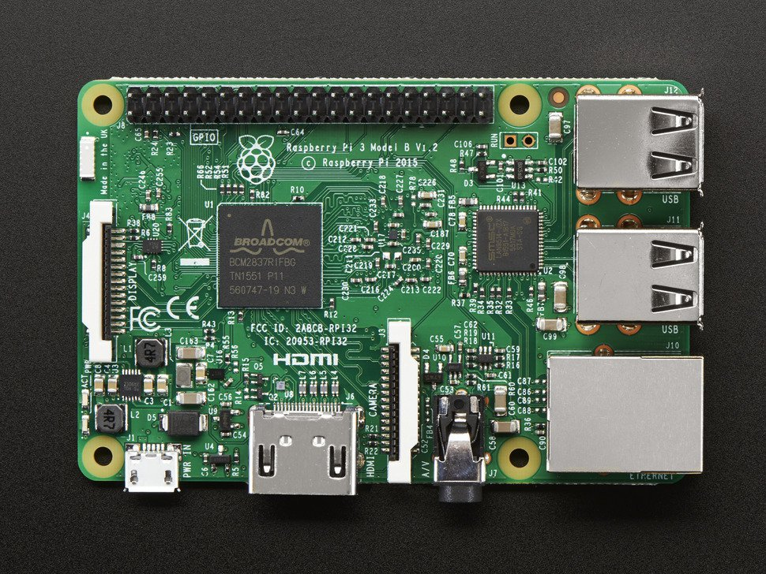
Hardware Platform
Raspberry Pi 3B [1]
OS: Raspbian
SOC: Broadcom BCM2837
CPU: 1.2 GHz 64/32-bit quad-core ARM Cortex-A53
Memory: 1 GB LPDDR2 RAM at 900 MHz
Power: 1.5 W to 6.7 W
Microarchitecture Details:
8-stage pipelined processor with 2-way superscalar, in-order execution pipeline
DSP and NEON SIMD extensions
VFPv4 Floating Point Unit onboard (per core)
64-byte cache lines
10-entry L1 TLB, and 512-entry L2 TLB
4 KiB conditional branch predictor, 256-entry indirect branch predictor
Notes:
S

Slide 6
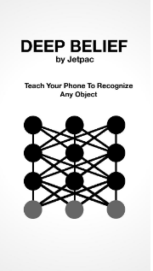

Software Platforms
DeepBeliefSDK [2]
Image recognition system under test
Designed for small-scale computing eg. iOS, Android, BeagleBone, etc.
Convolutional Neural Network based architecture optimized to run within the constraints of mobile systems [3]
Image recognition C/C++ library-based API
TensorFlow [4]
Production-grade system for comparison
General machine learning framework that is applicable in a wide variety of domains
Image recognition Python API
Notes:
S

Slide 7
Benchmarking
Notes:
A

Slide 8
Caltech101 Dataset Benchmark
Chose Caltech101 Image Dataset [5] because they corresponded with many of the categories from ImageNet 2012 [6]
DeepBeliefSDK and Tensorflow networks were trained on the same ImageNet 2012 images
Selected a representative subset of the intersection between Caltech101 and ImageNet 2012 categories to construct our benchmark to produce an overnight job that was feasible
Focused on recognition and not training
21 categories of 40 images each
~15 hours
Notes:
A

Slide 9
DeepBeliefSDK and TensorFlow Setup
DeepBeliefSDK Program
Altered example C program for single Linux image recognition run
Added in timing and prediction selection
Wrote values to csv file for analysis
TensorFlow Program
Modified image recognition example Python code for single recognition
Added timing and prediction selection
Wrote values to csv file for analysis
Test Script
Wrote shell script to run DeepBeliefSDK and TesnorFlow program over all 21 categories in our benchmark
Ran script overnight
Plotted and analyzed results
Notes:
A

Slide 10
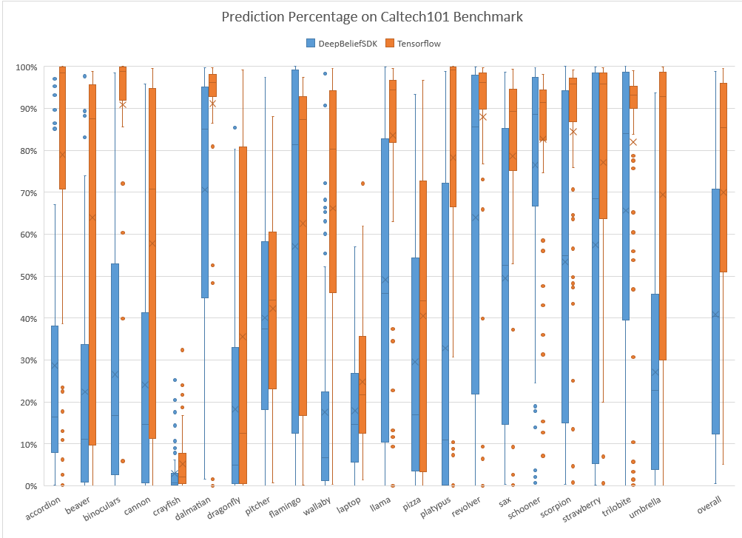
Prediction Accuracy
DeepBeliefSDK
Overall Accuracy: 40.86%
TensorFlow
Overall Accuracy: 69.94%
Notes:
A

Slide 11
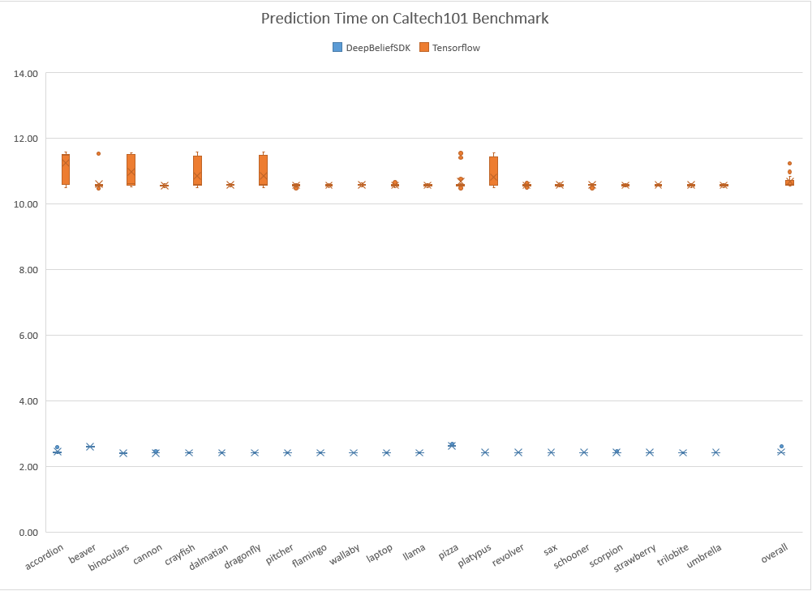
Prediction Speed
DeepBeliefSDK Overall Speed: 2.45s
TensorFlow
Overall Speed: 10.69s
Notes:
A

Slide 12
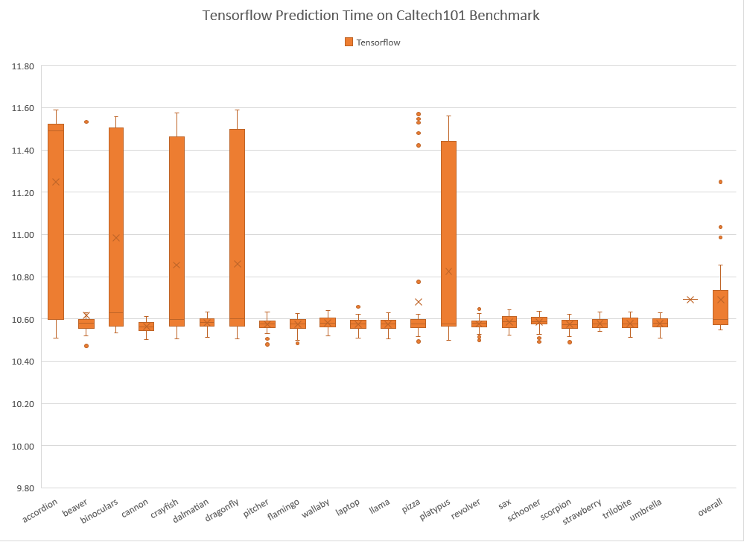
Prediction Speed
TensorFlow
Best Case: 10.45s
Worst Case: 11.59s
Notes:
A

Slide 13
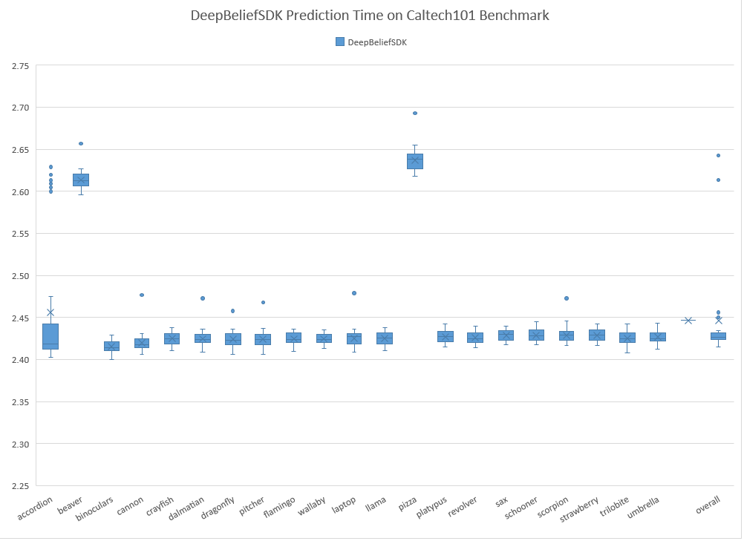
Prediction Speed
DeepBeliefSDK
Best Case: 2.41s
Worst Case: 2.69s
Notes:
A

Slide 14
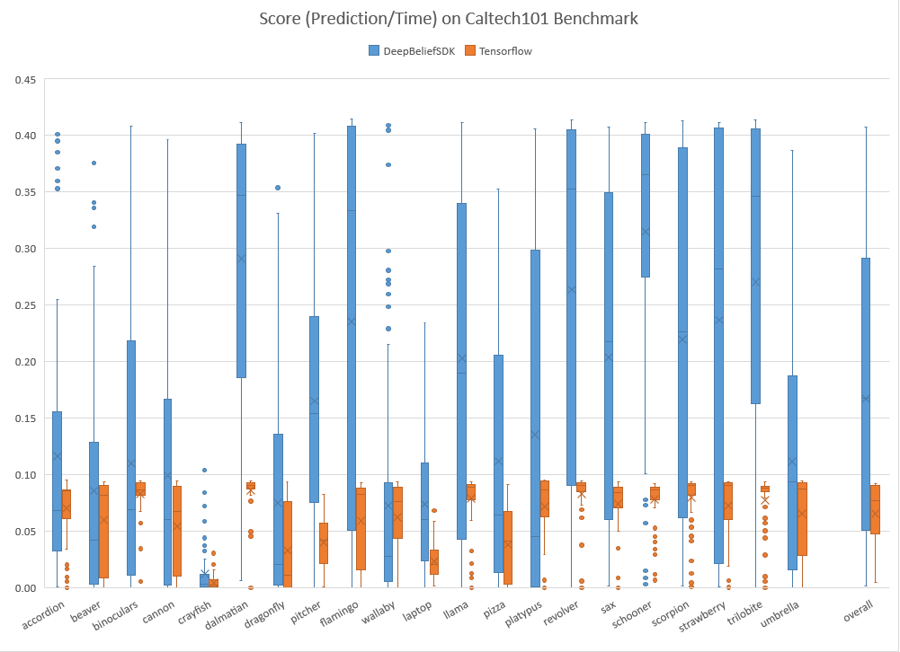
Prediction “Score”
Heuristics:
We equally weighted prediction percentage and time -- low time, high accuracy is optimal
Score = Pred(%) ➗Time(s)
DeepBeliefSDK
Overall Score: 0.167
TensorFlow
Overall Score: 0.065
Notes:
A

Slide 15
Research Questions
Notes:
S

Slide 16
Research Questions
Research Problems
Find any bottlenecks and hot code in DeepBeliefSDK’s execution
See what potential optimizations could be done improve the system
Research Implementation and Results
Used perf Linux Profiler to gather data and report
Analyzed perf data for module/function percentage and L1-DCache usage
Possible future work for optimization
Notes:
S

Slide 17
perf Linux Profiler [7]
perf capabilities:
perf allows the collection of events that occur in the Linux kernel
It can detect hardware events, software events, take snapshots of the kernel, etc.
Our strategy:
Run object file with “perf record” command prepended to collect perf.data
Run “perf report” and “perf stat” commands to analyze perf.data
For our setup, we profiled a DeepBeliefSDK single prediction pass on “Lena” at 99 Hz to gather data
Notes:
S

Slide 18
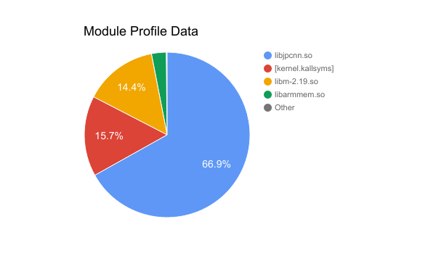
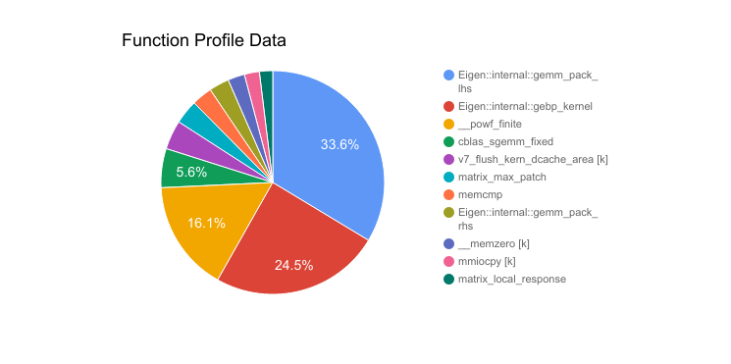
Module and Function perf Data on DeepBeliefSDK
Notes:
A

Slide 19
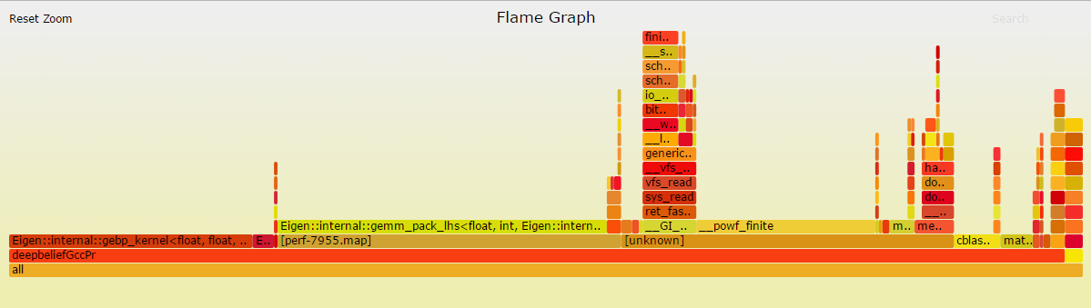
Flame Graph [8] of Single Pass
Flame Graphs show time spent in functions across the overall execution
We can see that the hottest code is in the Eigen library for matrix ops
We also see that some time is spent doing DCache flushes
https://puu.sh/vDVuO/503a6ca9cb.svg
Notes:
A

Slide 20
Eigen Library [9]
Eigen is a high-level C++ library for linear algebra operations
Most sources have said to try to apply OpenMP to exploit parallelization
Naively adding compiler flags to improve performance didn’t help
“-Ofast” and “-fopenmp” ran slower than “-O3”
2.66s vs 2.47s on average on CalTech101 Benchmark
Notes:
A

Slide 21
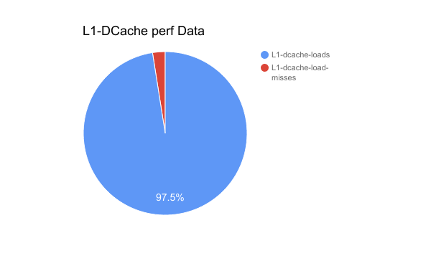
L1-DCache perf Data on DeepBeliefSDK
Notes:
S

Slide 22
Future Work
Focus optimization on Eigen and math libraries specific towards DeepBeliefSDK
Use more fine-grained parallelization techniques to make use of multicore architectures
Online profiling for FDO to improve speed
Predictable control-flow behavior
The execution spends a majority of the time in the same sequence of functions
We can exploit this behavior depending on the use cases
Notes:
S

Slide 23
Challenges Faced
Notes:
A

Slide 24
Challenges Faced
Getting software ported to Raspberry Pi
LLVM, DeepBeliefSDK
High current draw during 15 hour workload for benchmarking
Needed 2.5 A so system restarted midway
Replaced with a more stable source
Needed a larger SD card for the Pi to store data
Profiling techniques
Many useful LLVM profiling APIs were deprecated
GPROF was not working on our system
perf was a good solution
Lack of background knowledge in deep learning
Notes:
A

Slide 25
Conclusion
Notes:
A

Slide 26
References
[1] https://www.raspberrypi.org/products/raspberry-pi-3-model-b/
[2] https://github.com/jetpacapp/DeepBeliefSDK
[3] http://www.cs.toronto.edu/~hinton/absps/imagenet.pdf
[4] https://www.tensorflow.org/
[5] http://www.vision.caltech.edu/Image_Datasets/Caltech101/
[6] http://image-net.org/challenges/LSVRC/2012/browse-synsets
[7] http://www.brendangregg.com/flamegraphs.html
[8] https://github.com/brendangregg/FlameGraph
[9] http://eigen.tuxfamily.org/index.php?title=Main_Page

